Slide 1
Mastering .NET Aspire. From Fundamentals to Advanced Concepts.
Lukas Durovsky
Staff software engineer
KCDC 2025

Slide 2
Me
Software Engineer
~10 years of experience, various projects, mostly life science
Conference speaker, Workshop developer

Slide 3
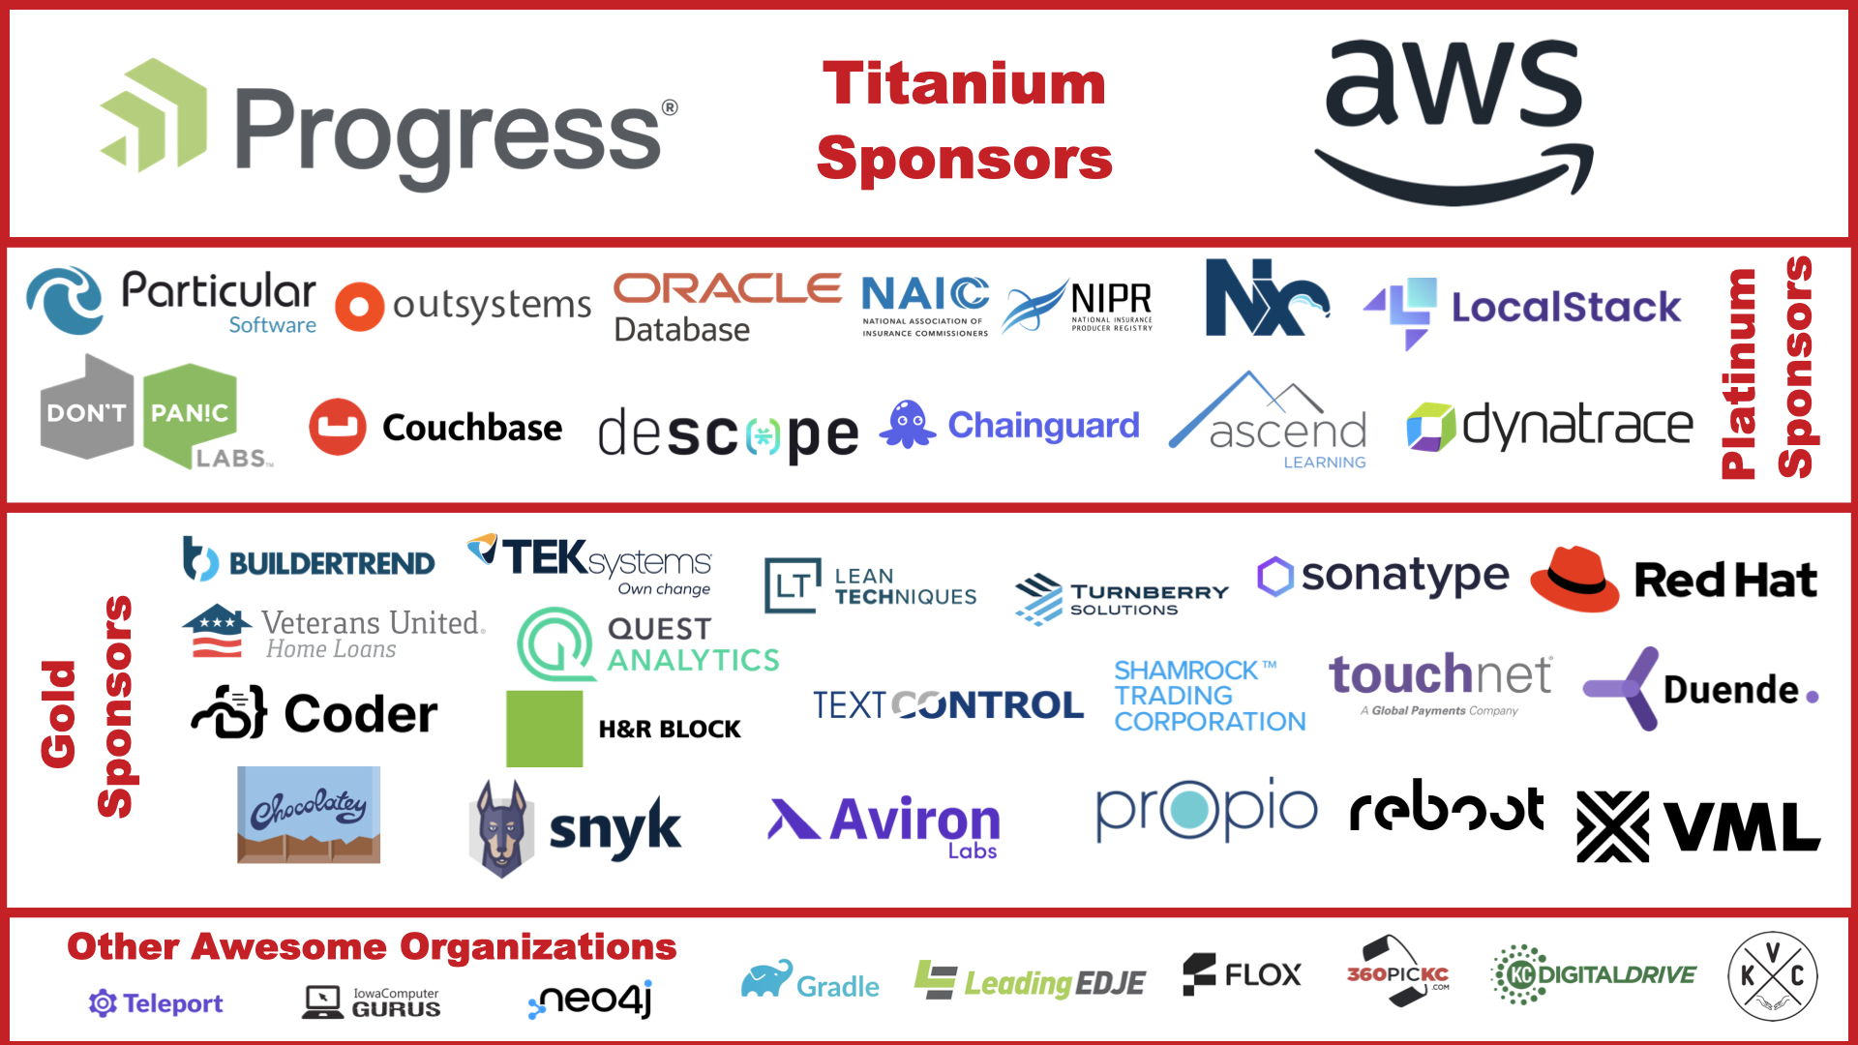

Slide 4
Workshop
Theory
Hands-on
Repository: https://github.com/xlukasd/WS-AspireApp

Slide 5
Workshop - Agenda
Introduction
Integrations
New service
MS-SQL, Azure Storage, RabbitMQ…
Dashboard
Deployment
Testing

Slide 6
Installing prerequisites
let’s make sure you have everything

Slide 7
Setup
.NET 8.0 / .NET 9.0
OCI (Open Container Initiative) compliant container runtime
Docker, Podman…
IDE
Visual Studio 2022 – version 17.9 or higher
VS Code
JetBrains Rider + .NET Aspire plugin
Azure Developer CLI
https://learn.microsoft.com/en-us/dotnet/aspire/fundamentals/setup-tooling

Slide 8
Introduction

Slide 9
Some challenges of service-oriented architectures & cloud-native apps
System architecture
What (micro)services the system is built of?
What backing services are there for each (micro)service?
Onboarding
Communication
Service discovery
Dependency management

Slide 10
Some challenges of service-oriented architectures & cloud-native apps
Resiliency
Temporal service downtime
Retries, Timeouts, Circuit Breaker
Development runtime – ‘development inner loop’
Running the application locally
Observing the behavior, Debugging, Performance analysis

Slide 11
What .NET Aspire is?
Stack for building cloud-native applications in .NET
Dev-time orchestration tool
You just press F5 and in a while, everything is ready to be debugged

Slide 12
What problems does .NET Aspire solve?
“.NET Aspire's strength lies in its ability to provide an amazing developer inner-loop”
Local Development Orchestration and Setup Complexity
Service Discovery & Connection Management
Arguments passing
Observability configuration
Telemetry, Tracing, Metrics, Health-checks
Boilerplate code
Resilience (Retries, Circuit Breakers…)

Slide 13
What .NET Aspire is not?
Deployment tool
Replacement for existing cloud infrastructure
AKS, Azure Container Apps, Amazon Elastic Kubernetes Service
Silver bullet for all problems related to cloud/microservices/distributed world
Standalone tool meant to be used in isolation

Slide 14
Pitfalls
All your (micro)services must be in same solution
You can partially solve this by ‘.AddDockerFile’, ‘.AddContainer’, ‘.AddExecutable’
Support and documentation
Emerging technology, lot of changes very often
https://learn.microsoft.com/en-us/dotnet/aspire/whats-new/dotnet-aspire-9.4
I see some similarities to GitHub Copilot
Major changes between versions
Articles on the Internet may be just a few weeks old, but they are for older version
🤖 GitHub Copilot support
Inappropriate completions
Getting some suggestion from .NET Aspire 9.2 SDK, but I am using 9.3

Slide 15
Relationship with well-known tools
Docker
Might be used for some components (Redis, PostgreSQL…) in your .NET Aspire App
Docker Compose
Declarative - Imperative
YAML - C#
Developers can use something they already know, no need to learn something new
Just Containers vs. Different kind of integrations
Kubernetes
Aspire can create manifest list that can be used for deployment to Kubernetes
Dapr, Orleans…

Slide 16
Hello world!
Let’s see HOW IT WORKS

Slide 17
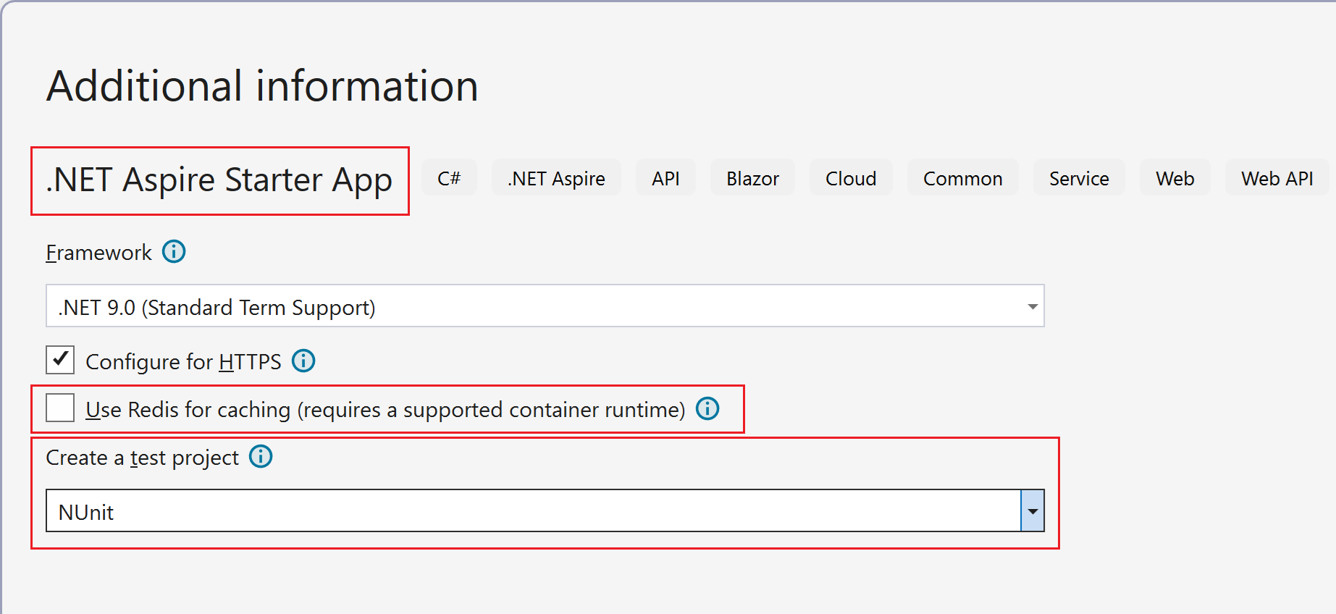

Slide 18
ServiceDefaults project
Cross-cutting concerns of cloud-native apps
Health checks
Telemetry
Service discovery
Resiliency
HttpClient configuration
Can be customized to fit specific needs

Slide 19
AppHost project
App model definition
Resources - references, relationships
Integrations
Orchestration
Delegated to Developer Control Plane (DCP) - Core of the project
Startup project

Slide 20
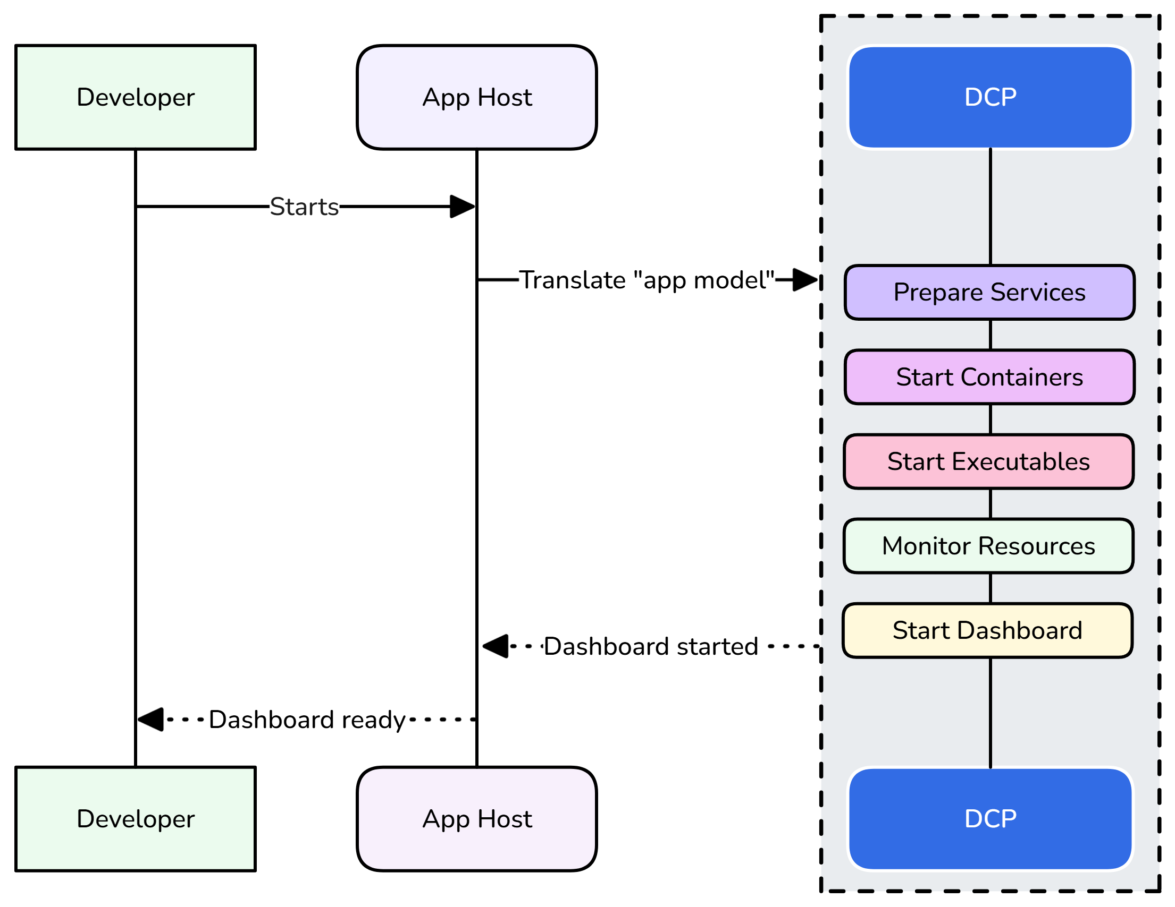

Slide 21
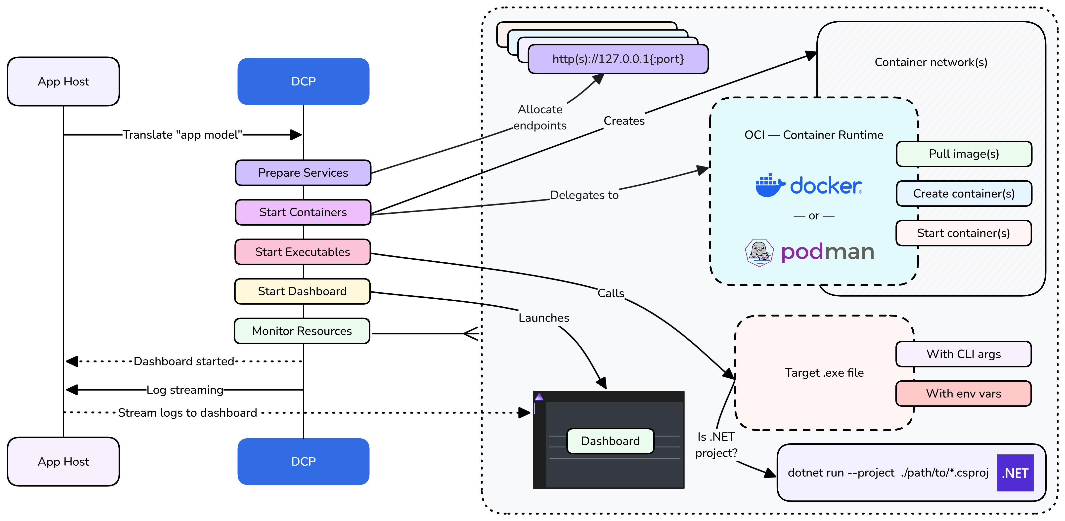

Slide 22
AppHost project – important files
Program.cs
Here the app model is defined
appsettings.json
Here you put Parameter values, Connection strings, Azure subscription info …

Slide 23
AppHost project – modes
Run mode – local development, testing, debugging
Publish mode – deployment artifacts generation

Slide 24
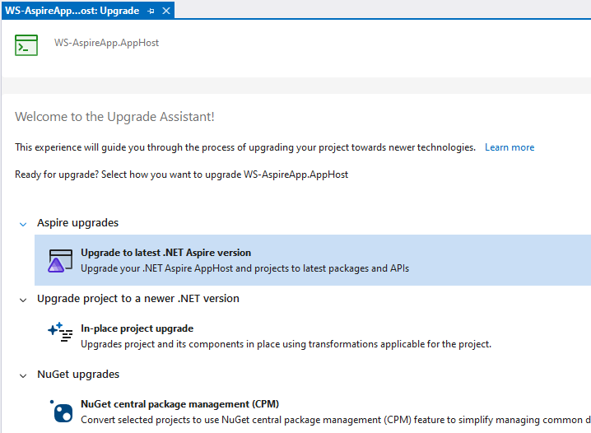
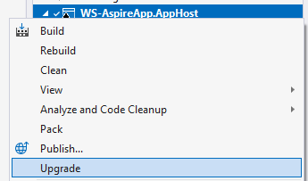
AppHost project – upgrades

Slide 25
AppHost – synchronization
.WithExplicitStart()
.WaitFor(resource)
Enforce resource start - dashboard

Slide 26
AppHost – service discovery
.WithReference(…)
Environment variables
Naming conventions

Slide 27
🏋️‍♂️ Hands-on #0
Adding another service to your app + RabbitMq
📁 WS-AspireApp-HandsOn\00-AddDummyServiceRabbitMq
👣 Steps:
Add project reference to ‘Dummy service’ into AppHost
Add DummyService to app model in AppHost/Program.cs
In app model, inject reference to DummyService into ApiService
Create DummyServiceHttpClient in ApiService with method ‘GetDummyData’
Add DummyServiceHttpClient to dependency injection in ApiService
In ‘/storedFiles’ GET, call GetDummyData
Add RabbitMq integration to app model in AppHost
Add RabbitMq integration to DummyService
Let’s inspect environment variables

Slide 28
What can you add to your app model?
.AddProject
.AddExecutable
.AddDockerFile
.AddParameter, .AddConnectionString
Add something, that is resolved as a container
.AddSqlServer, .AddRedis…
Add Azure resource
.AddAzureStorage, .AddAzureCosmosDB …

Slide 29
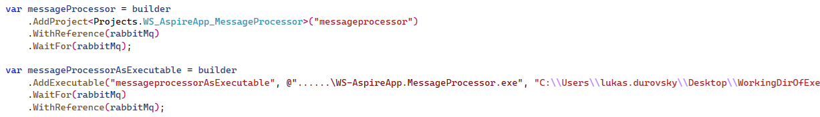

Slide 30
Integrations

Slide 31
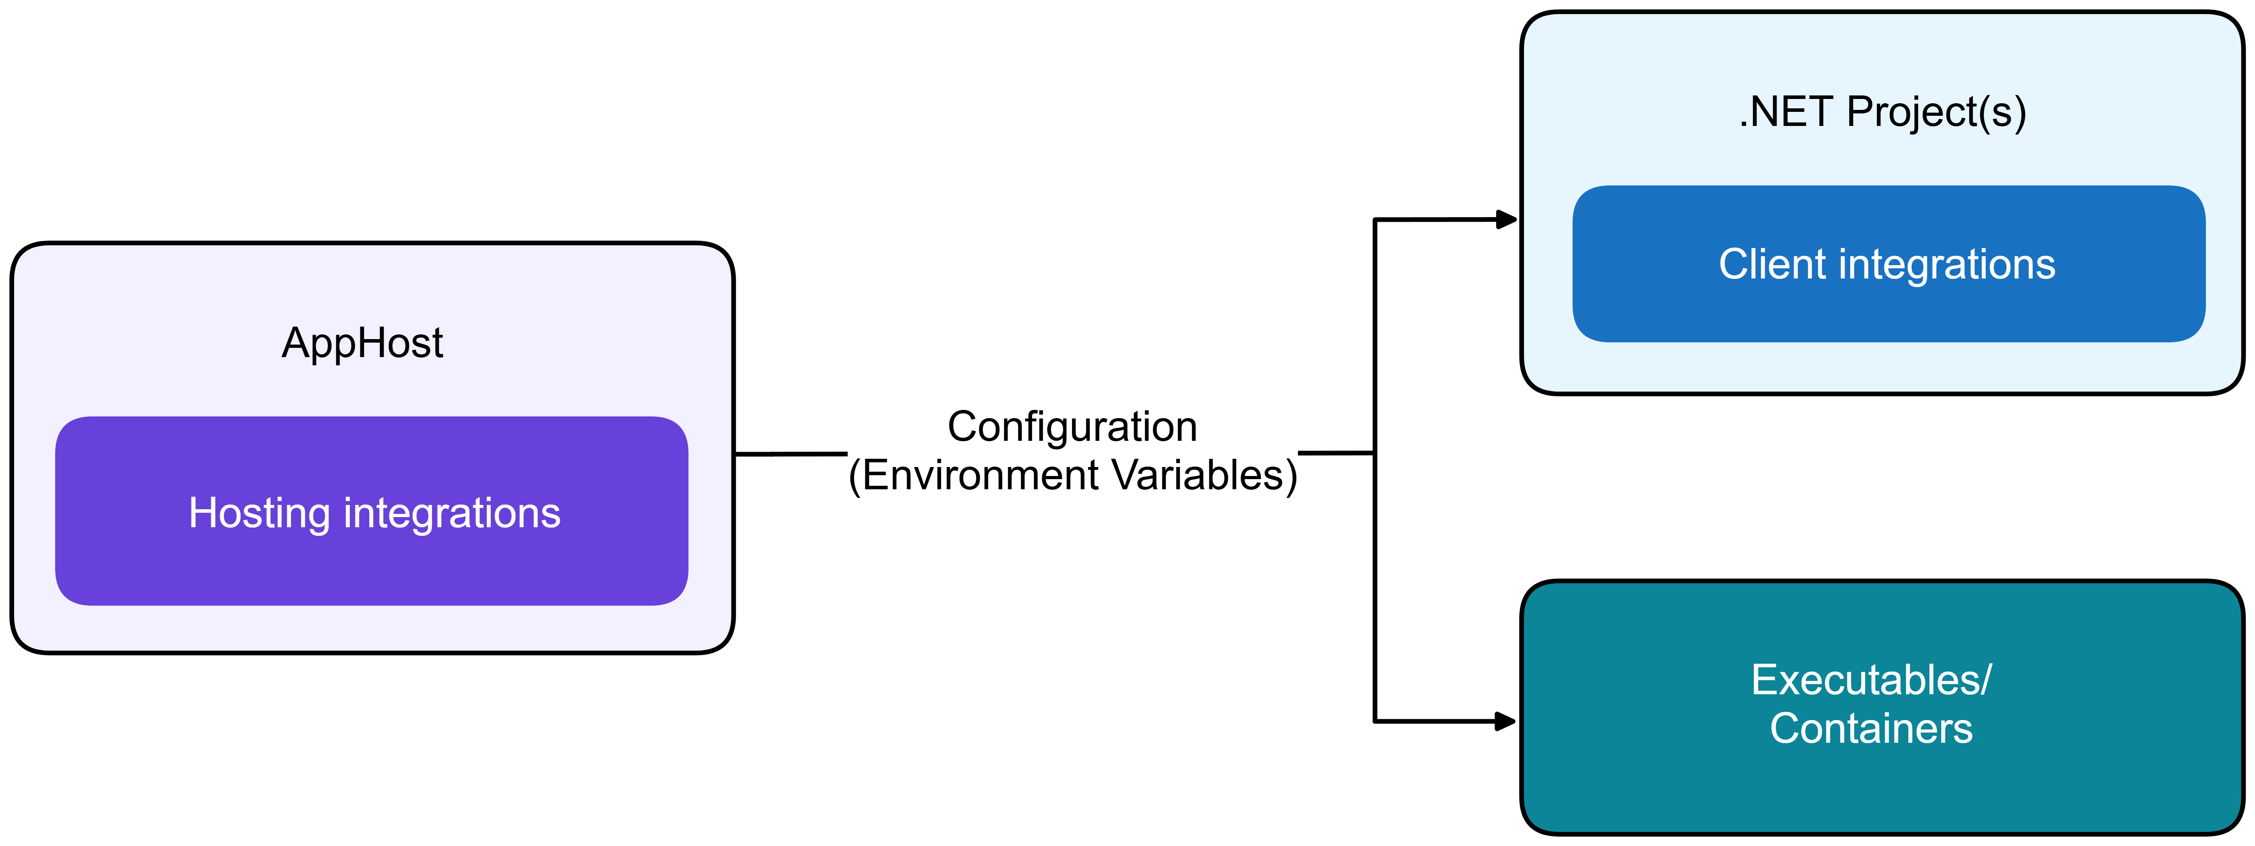
Integrations
One of the core features of .NET Aspire
Let you easily integrate common backing services to your app
RabbitMQ, Redis, SQL, Azure resources...
Two kinds of integrations
Hosting – used in AppHost project
Client – used in your services
Mostly used in pairs

Slide 32
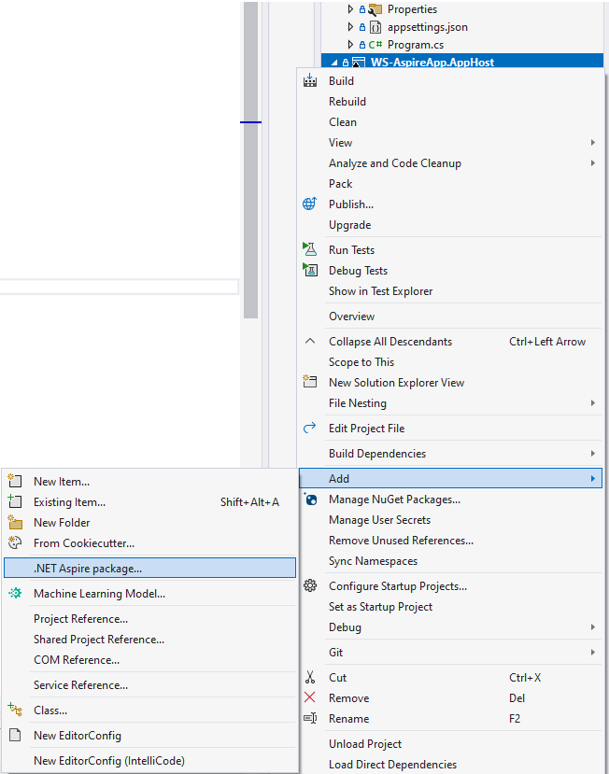
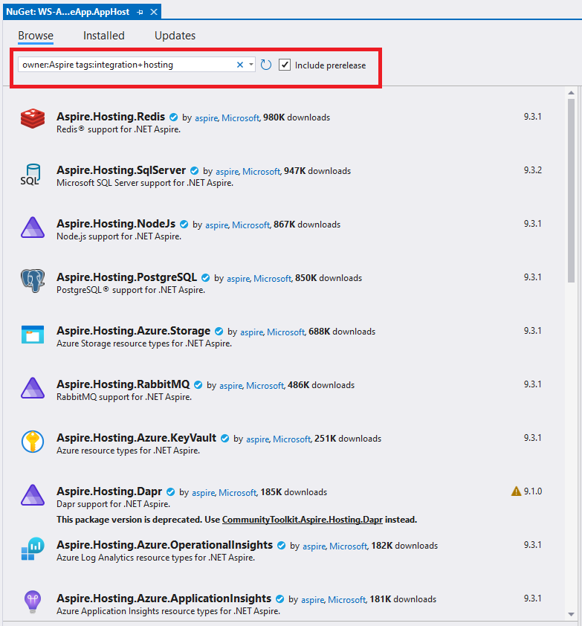
Integrations - Hosting

Slide 33
Integrations - Hosting
Responsible for
Provisioning / running the resource
Projects
Containers
Executables
Injecting correct configuration details into the resource
ConnectionStrings, Endpoint URLs...

Slide 34
Integrations – Hosting - Modes
Run mode – ‘builder.ExecutionContext.IsRunMode’
Publish mode – ‘builder.ExecutionContext.IsPublishMode’
Various extension methods
RunAsContainer (AzureSql, …)
RunAsEmulator (AzureStorage, …)
PublishAsConnectionString (RabbitMQ, …)
ExcludeFromManifest

Slide 35
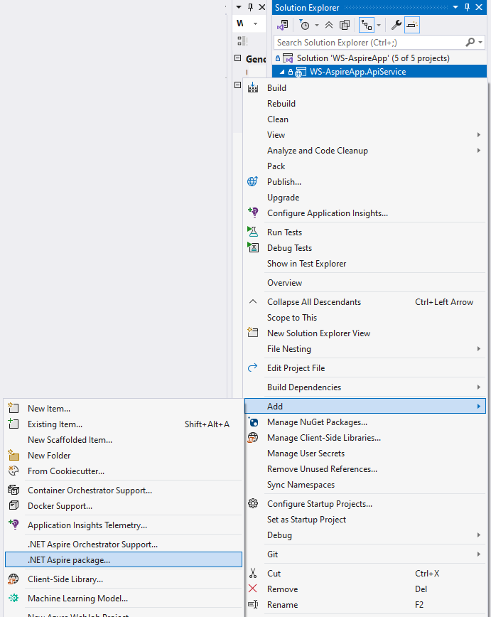
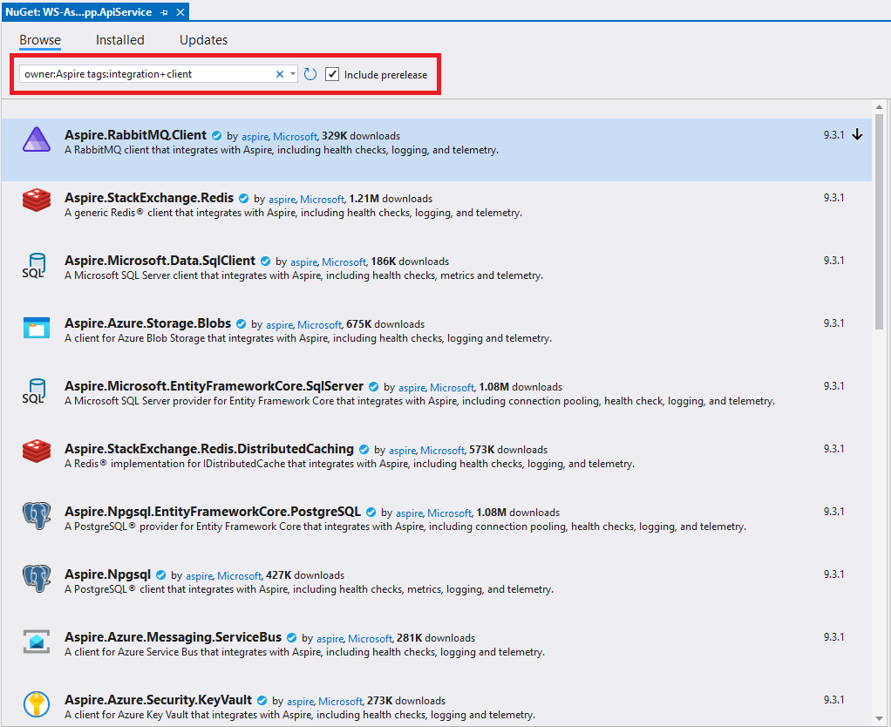
Integrations - Client

Slide 36
Integrations - Client
Responsible for
Configuring the dependency injection
Configuring resolved instance based on environment variables
BlobServiceClient
EF.Core ‘DbContext’
RabbitMQ’s ‘IConnection’
Configuring possible health checks
DB connection can be established, and query can be executed
Configuring tracing

Slide 37
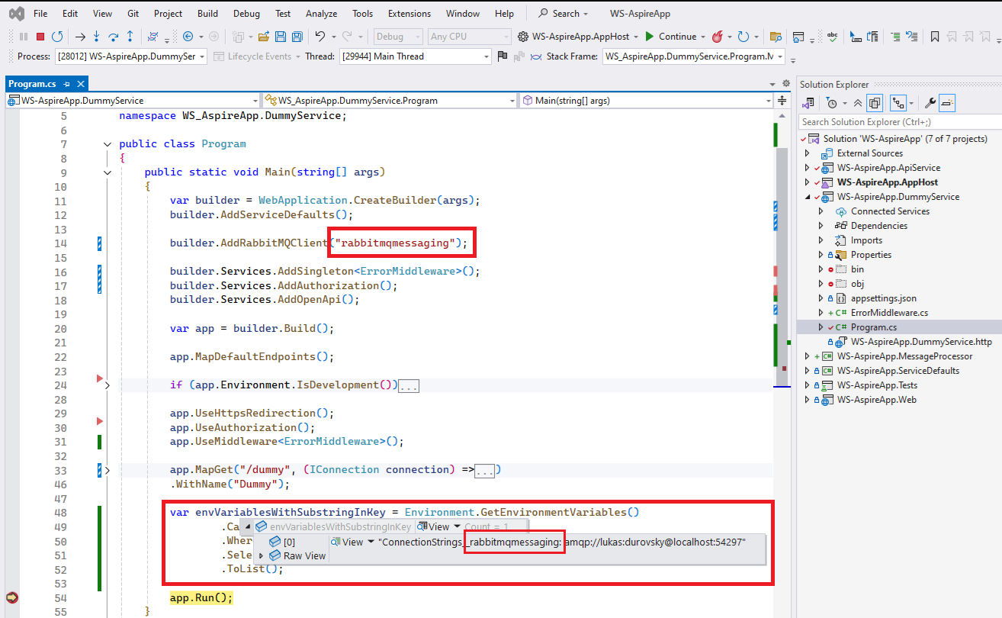
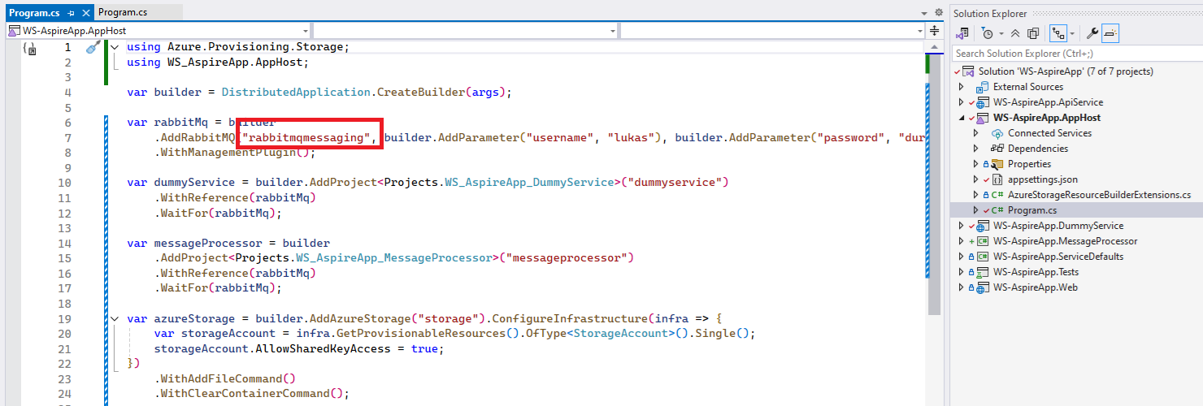

Slide 38
Integrations
Customizations, settings
Disable HealthChecks
DisableTracing

Slide 39
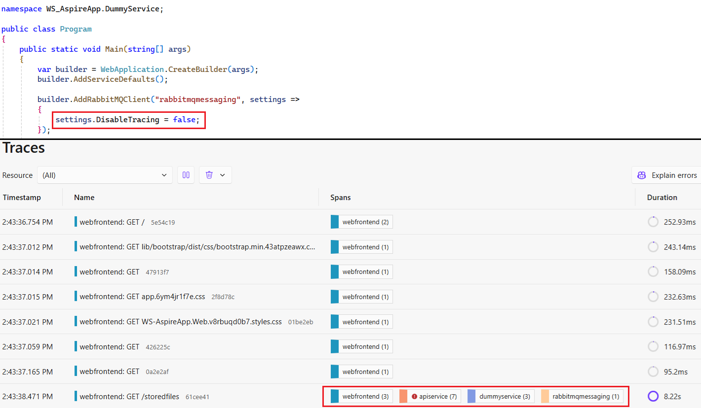

Slide 40
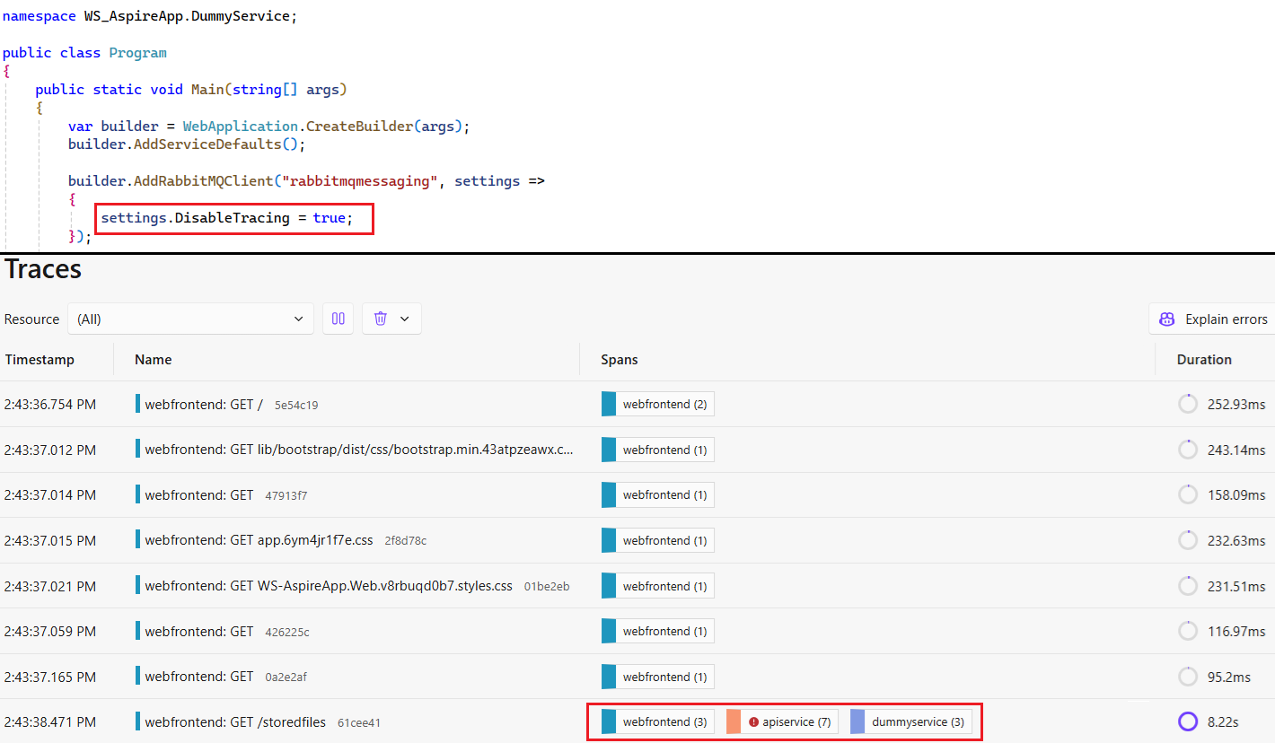

Slide 41
🏋️‍♂️ Hands-on #1
Integration of MS SQL database - as ConnectionString
📁 WS-AspireApp-HandsOn\01-MsSqlAsConnectionString
📋 Prerequisites
Execute sql-script in ‘sql-script.txt’
👣 Steps:
Add connection string to app-model
Pass this connection string to the ApiService in app-model
Add Aspire EF Core integration to the ApiService

Slide 42
🏋️‍♂️ Hands-on #2
Integration of MS SQL database – as Container
📁 WS-AspireApp-HandsOn\02-MsSqlAsContainer
📋 Prerequisites
Hands-on #1
👣 Steps:
Add Aspire.Hosting.SqlServer integration to AppHost
Change SQL Server connection string to MS SQL Server integration in AppHost

Slide 43
🏋️‍♂️ Hands-on #3
Integration of MS SQL database – as Azure resource
📁 WS-AspireApp-HandsOn\03-MsSqlAsAzureResource
📋 Prerequisites
Hands-on #2
🕳️ Problems
Initial script – let’s use Azure Data Studio
az sql server ad-only-auth disable --resource-group <myresource> --name <myserver>
👣 Steps:
Configure ‘appsettings.json’ with “Azure” section
Change SQL Server integration Azure SQL integration in AppHost

Slide 44
🕸️ Hands-on #3 - Deployment to Azure
Resource provisioning / deprovisioning
Resources must be manually deprovisioned when finished
When stopping and rerunning the application, previously provisioned stuff is used
.ConfigureInfrastructure(…) method

Slide 45
🏋️‍♂️ Hands-on #4
Integration of Azure Storage - error
📁 WS-AspireApp-HandsOn\04
🕳️ Problems
Poland Central does not support this type of storage
👣 Steps:
Configure ‘location’ in ‘appsettings.json’ with ‘polandcentral’
Add Azure Storage integration to ApiService
Add Azure Storage integration to AppHost
Try to run the solution with F5
Observe failure

Slide 46
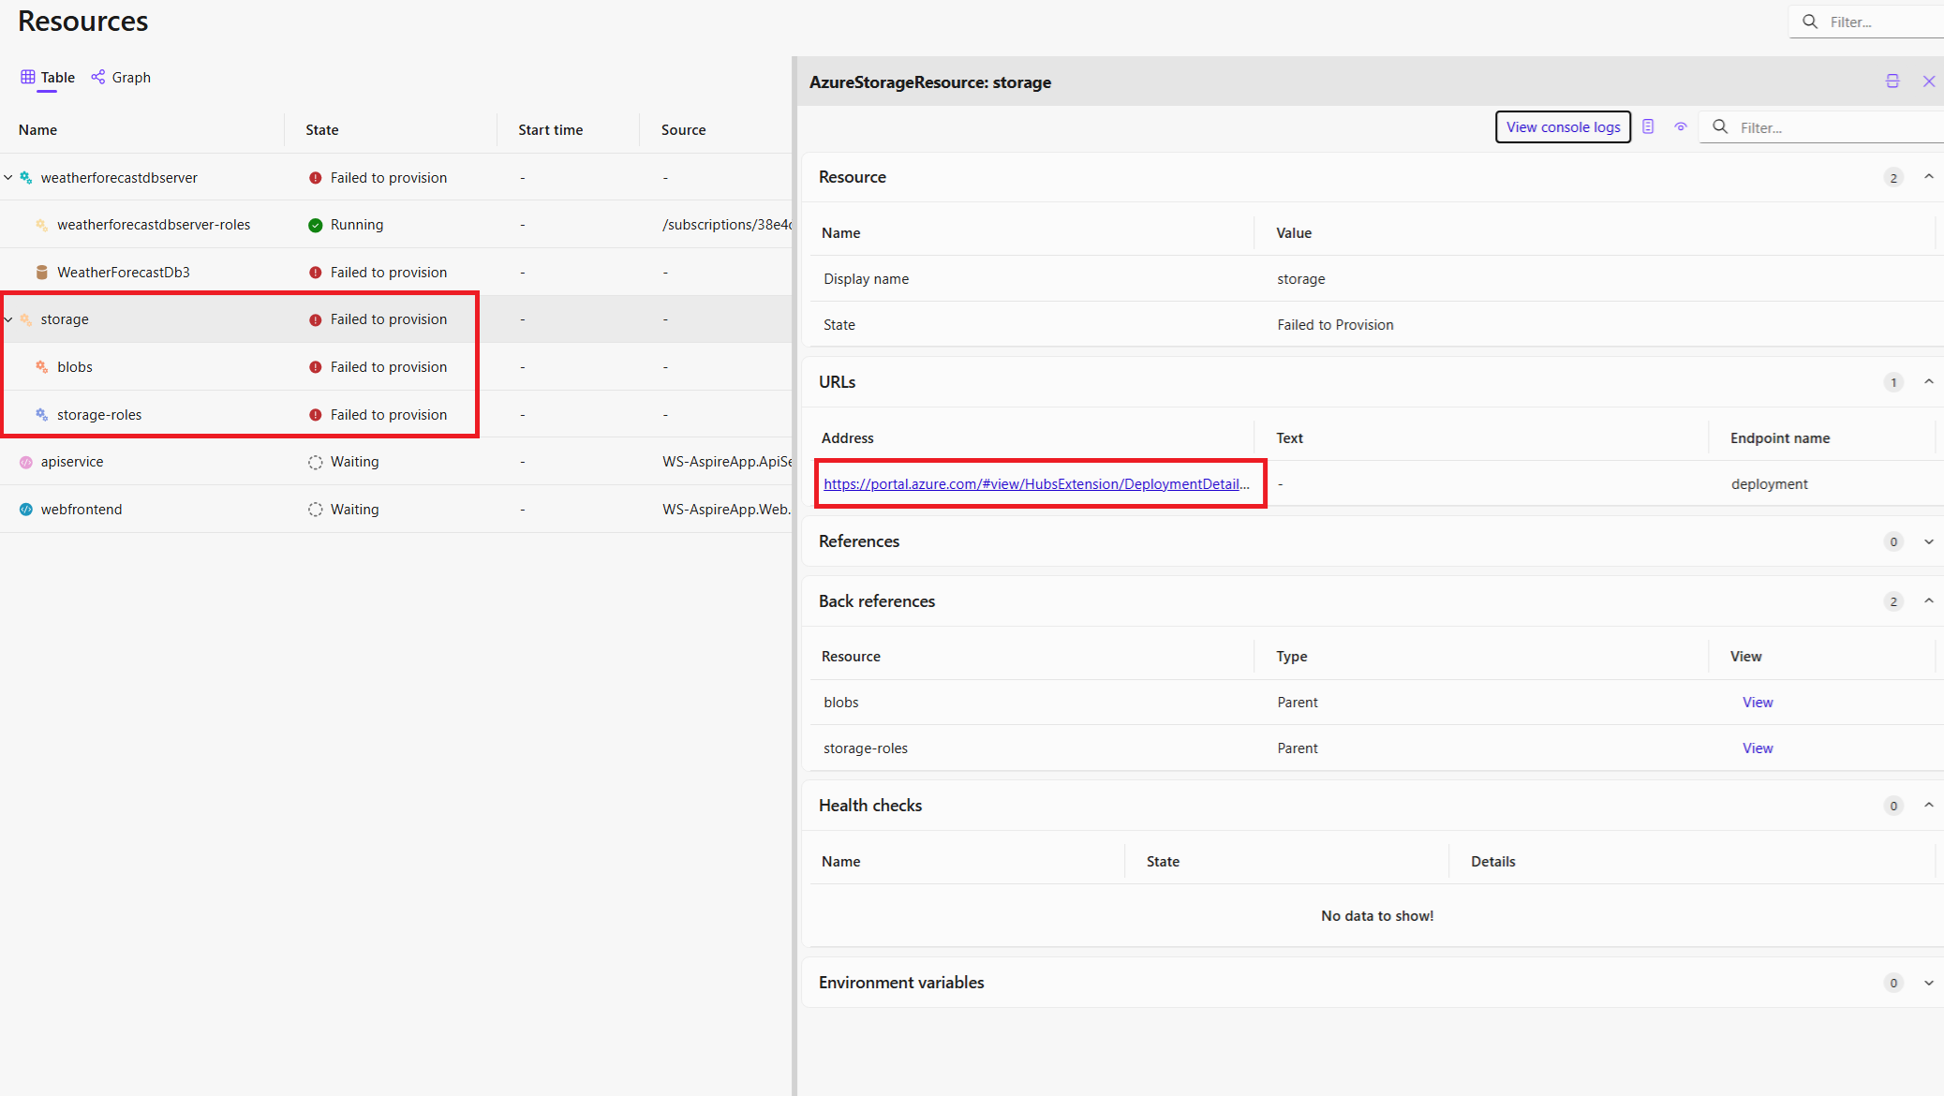

Slide 47
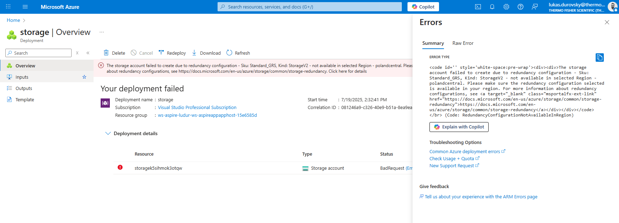

Slide 48
🏋️‍♂️ Hands-on #5
Integration of Azure Storage
📁 WS-AspireApp-HandsOn\05-AzureStorage
📋 Prerequisites
Hands-on #4
az storage account update --resource-group {resource_group} --name {storage_account_name} --allow-shared-key-access true
👣 Steps:
Change ‘location’ in ‘appsettings.json’ with ‘northeurope’ / ‘eastus’ / ‘westus’
Try to run the solution with F5
Observe successful behavior
⚙️ Options:
RunAsEmulator – no need to provision to Azure during development, just when Publishing

Slide 49
Dashboard

Slide 50
1. Resources
Resources, that your app is composed of
Projects, Containers, Executables, Azure Resources…
Different kind of visualizations
Table
Graph

Slide 51
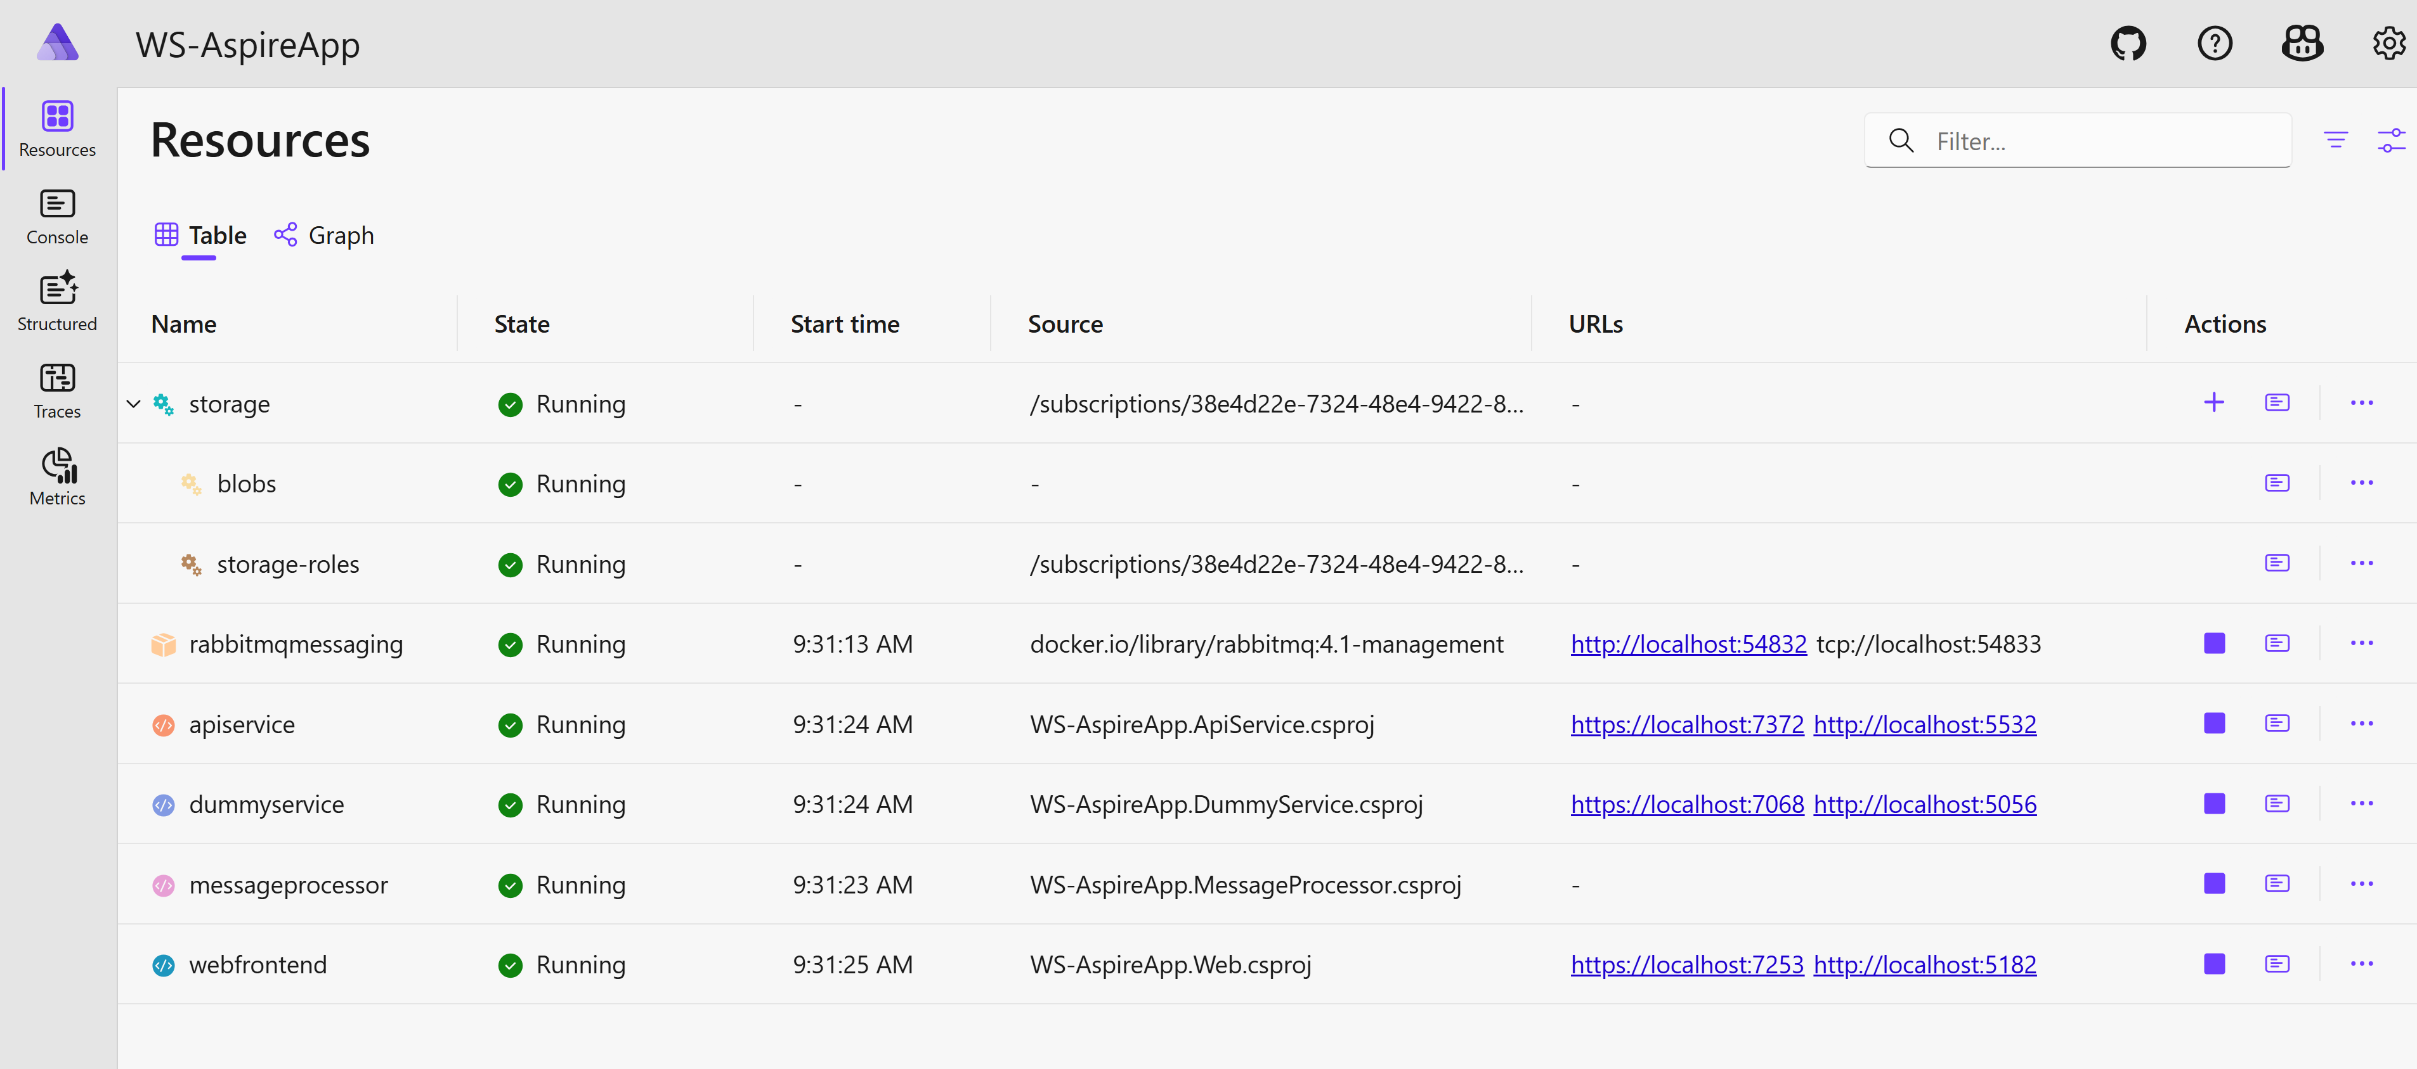

Slide 52
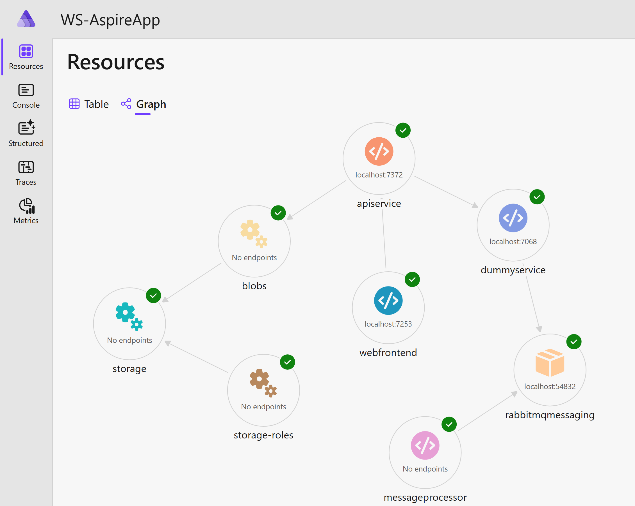

Slide 53
2. Custom commands
You can write your own commands for resource
Clearing data
Adding data
Executing scripts
…
.WithCommand<Tresource>(…)
.WithHttpCommand<Tresource>(…)
Logs from command-run are available in log of corresponding resource
⚠️ Commands are available just in development mode, not when deployed

Slide 54
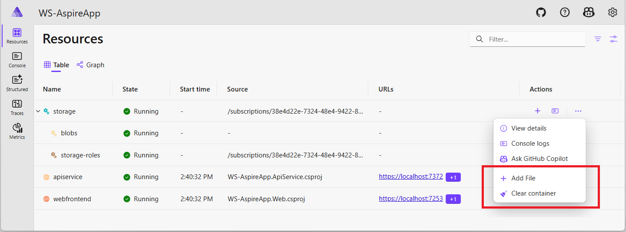

Slide 55
🏋️‍♂️ Hands-on #6
Writing custom commands for Azure Storage – AddFile, ClearContainer
📁 WS-AspireApp-HandsOn\06-CustomCommands-AzureStorage
📋 Prerequsities
Exercise #5 completed
👣 Steps:
Create new class for extension methods
Add extension methods
‘public static IResourceBuilder<AzureStorageResource> WithAddFileCommand(this IResourceBuilder<AzureStorageResource> builder)’
‘public static IResourceBuilder<AzureStorageResource> WithClearContainerCommand(this IResourceBuilder<AzureStorageResource> builder)’
Add code to those methods

Slide 56
3. GitHub Copilot
You can use your AI-buddy even here ☺
Only available, when app run from IDE
GitHub account, valid Copilot subscription
🎬 Authorization failure in Clear Container custom command

Slide 57
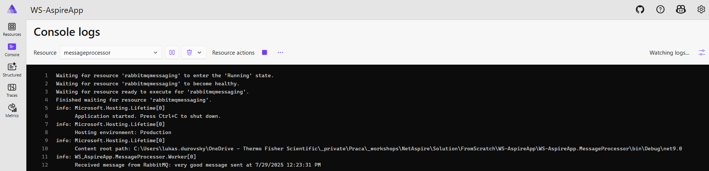
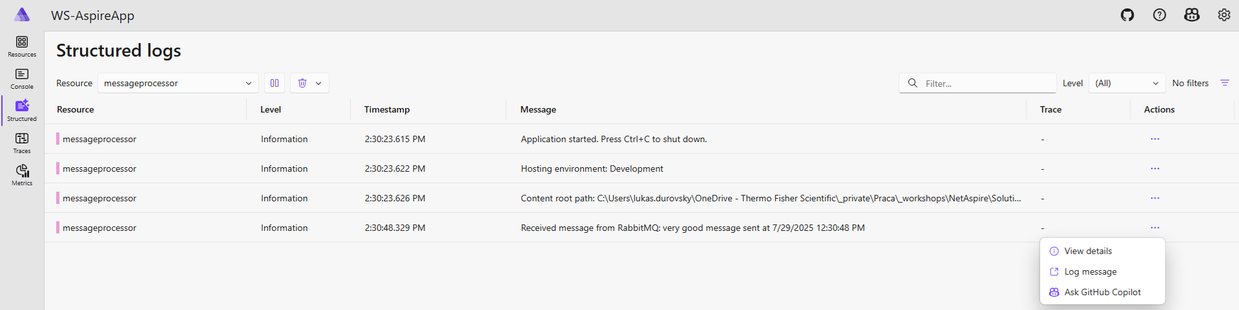
4. Console & Structured logs

Slide 58
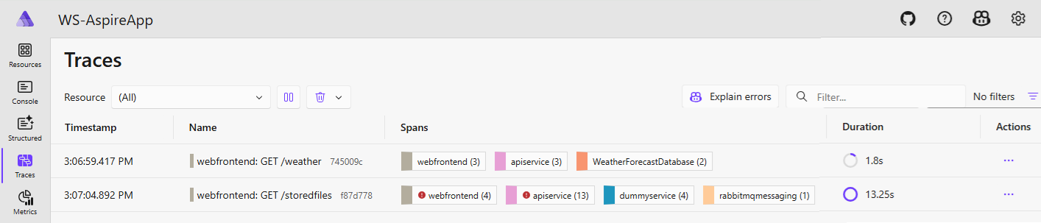
5. Traces
This is the consequence of ‘.AddServiceDefaults’ call in all appropriate places

Slide 59
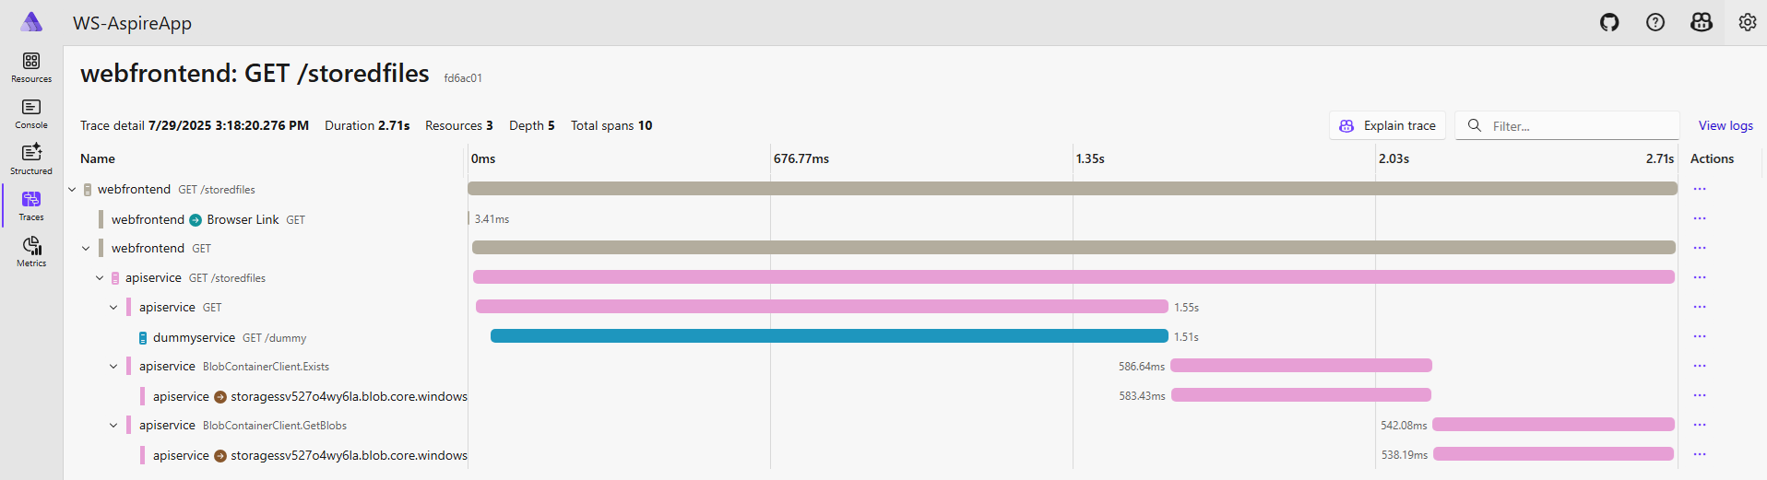

Slide 60
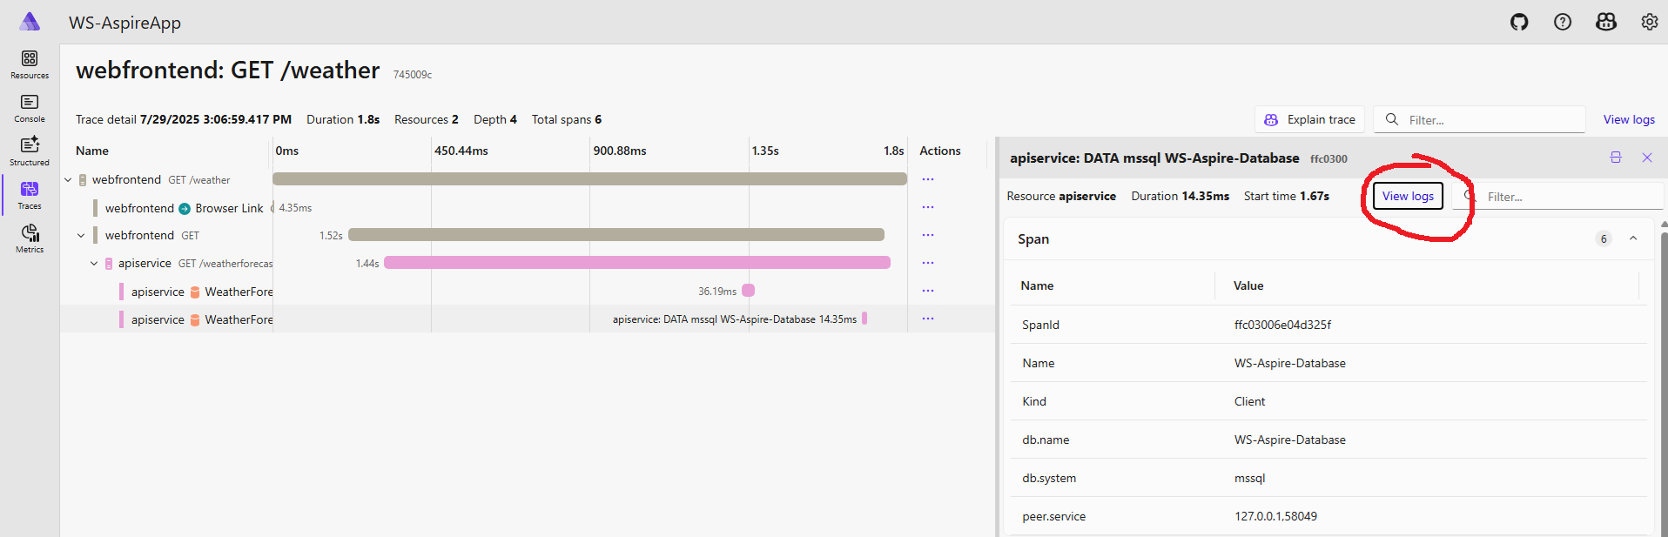
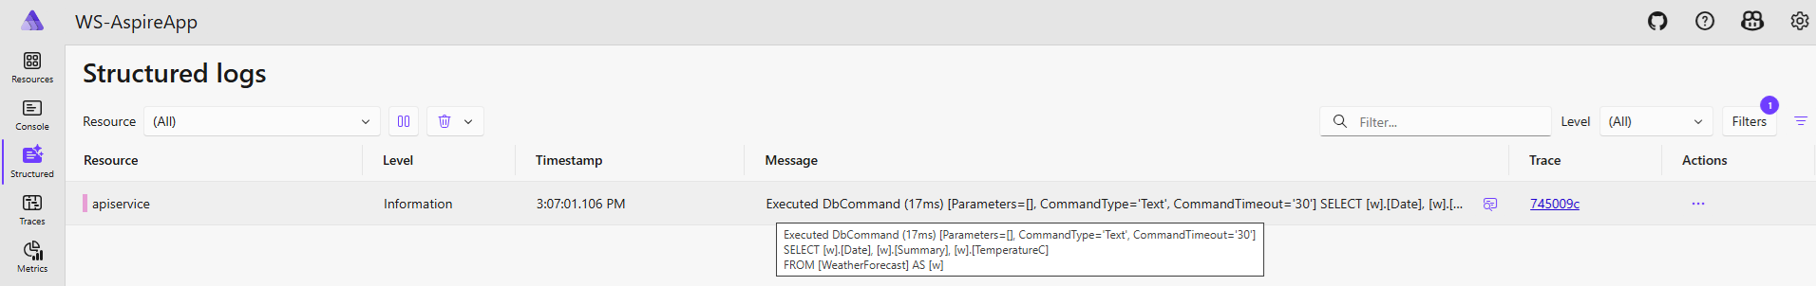

Slide 61
Eventing

Slide 62
Events
AppHost events
BeforeStartEvent, ResourceEndpointsAllocatedEvent, AfterResourcesCreatedEvent
Resource events
InitializeResourceEvent, ResourceEndpointsAllocatedEvent, ConnectionStringAvailableEvent, BeforeResourceStartedEvent, ResourceReadyEvent

Slide 63
Deploying

Slide 64
More options
Visual Studio
Azure Developer CLI (azd)
Aspir8
Publish to Docker Compose

Slide 65
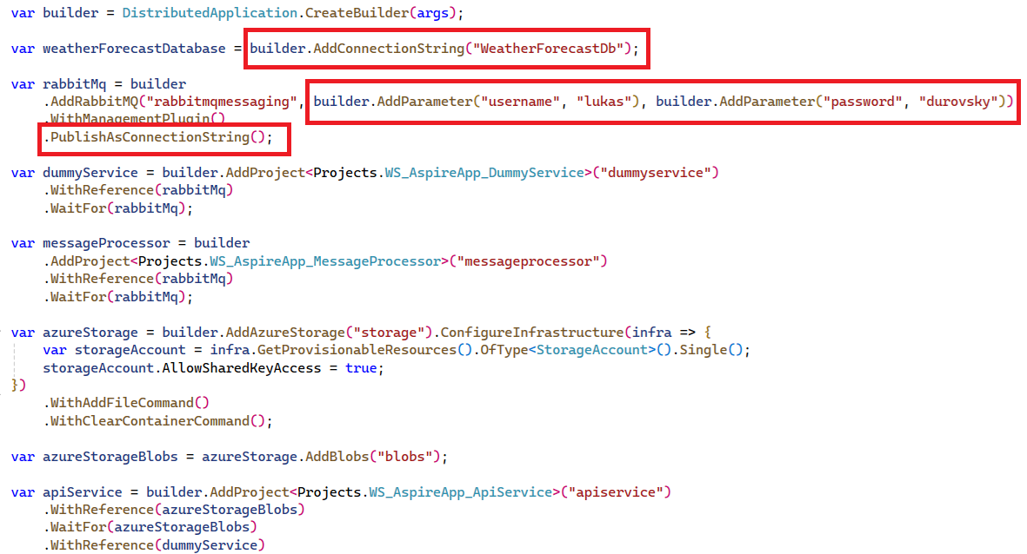

Slide 66
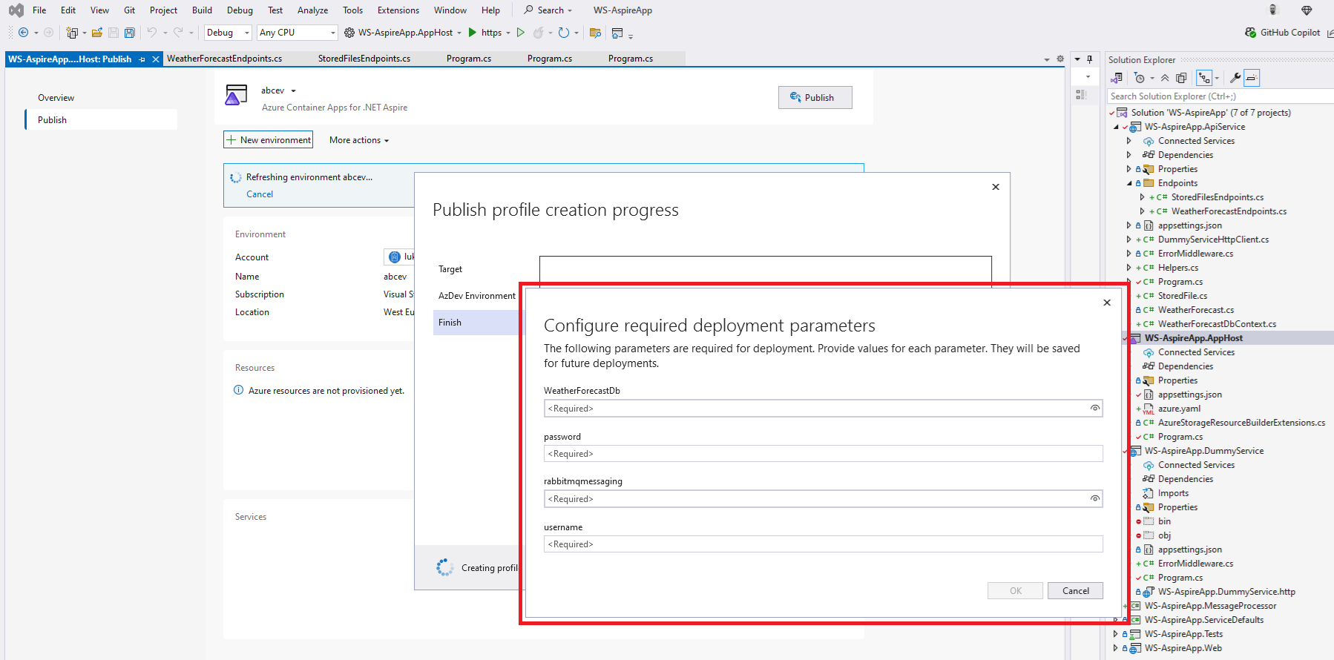

Slide 67
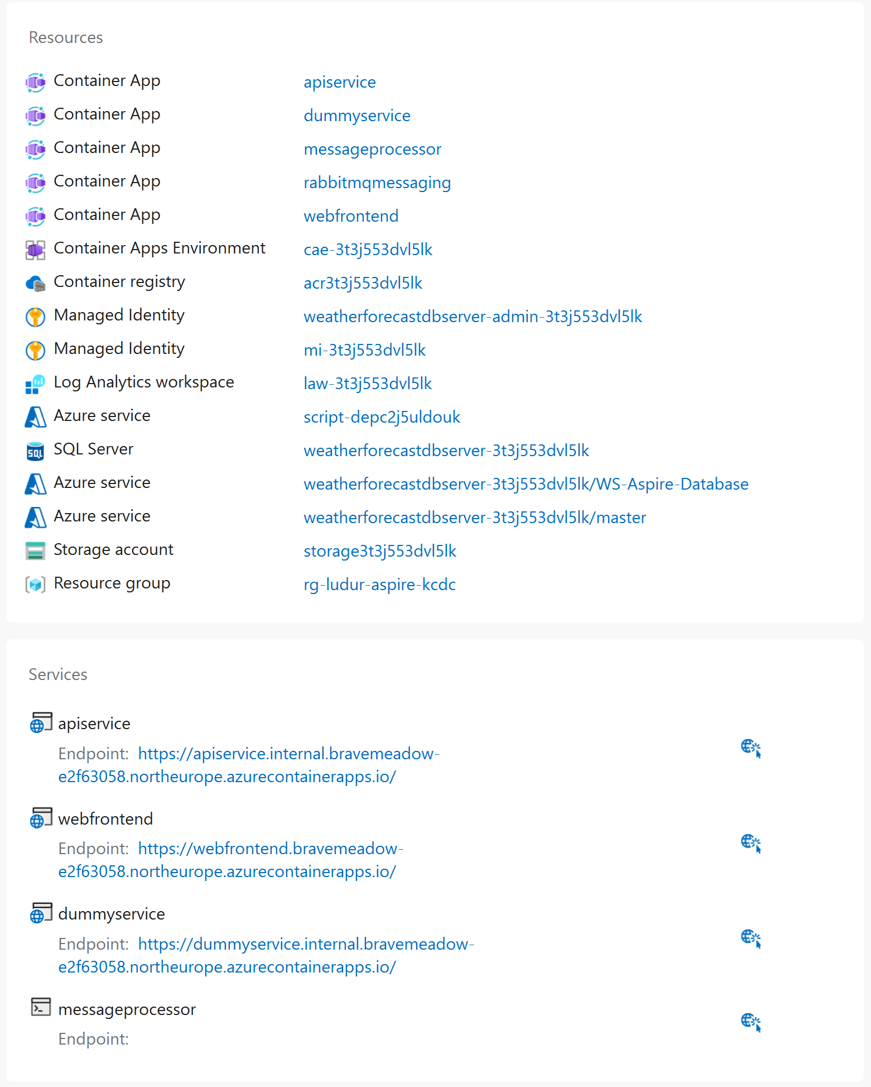

Slide 68
🏋️‍♂️ Hands-on #7a
Deployment to Azure – using Visual Studio
📋 Prerequsities
AppHost/Program.cs from Hands-on #3
🕳️ Problems
.ConfigureInfrastructure – let’s specify username and password for SQL server
az sql server ad-only-auth disable --resource-group <myresource> --name <myserver>
Initial script – let’s use Azure Data Studio
👣 Steps:
Use ConfigureInfrastructure method on AzureSql integration to specify username and pw
Right click on AppHost project, and select Publish
Create environment, and then Publish
Wait
Check Output window for Dashboard URL
Insert data to SQL via Azure Data Studio

Slide 69
🏋️‍♂️ Hands-on #7b
Deployment to Azure – using ‘azd’ tool
📋 Prerequsities
AppHost/Program.cs from Hands-on #3
🕳️ Problems
.ConfigureInfrastructure – let’s specify username and password for SQL server
az sql server ad-only-auth disable --resource-group <myresource> --name <myserver>
Initial script – let’s use Azure Data Studio
👣 Steps:
Use ConfigureInfrastructure method on AzureSql integration to specify username and pw
Use command ‘azd auth login’
Use command ‘azd init’
Use command ‘azd up’
Use command ‘azd monitor’

Slide 70
Testing

Slide 71
Testing
Test project can be added, when creating Aspire App, or later

Slide 72
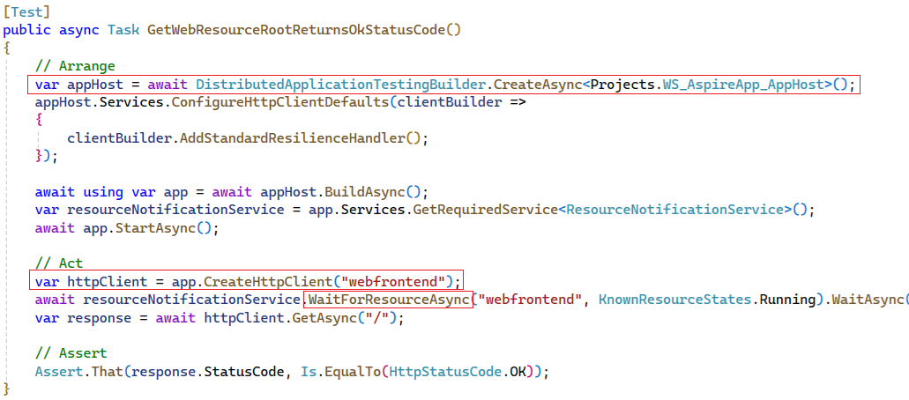
Testing
Usage of DistributedApplicationTestingBuilder

Slide 73
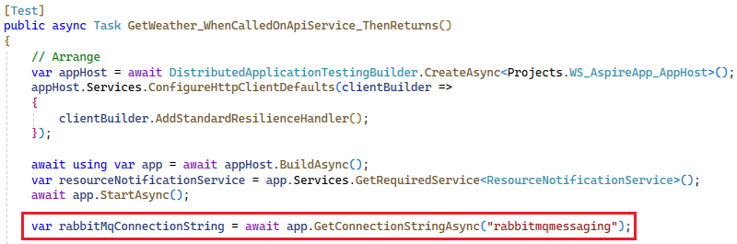
Testing
Get connection string to some resource
Naming – you must use same name as in AppHost/Program.cs file

Slide 74
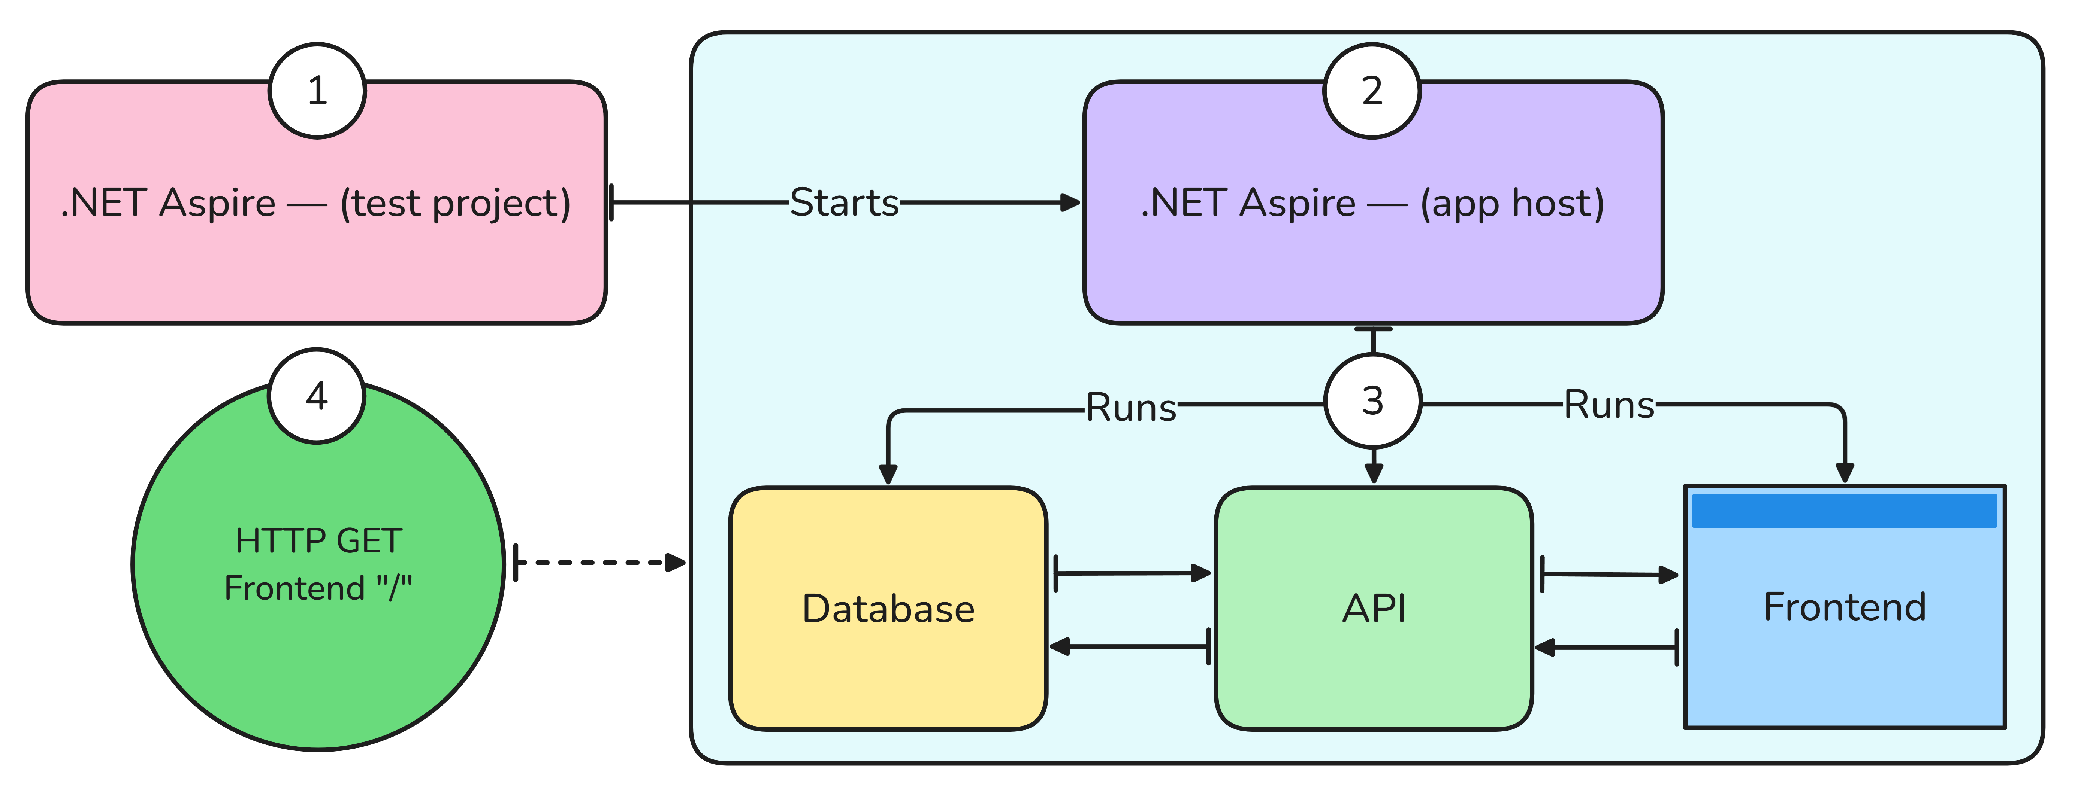
Testing
Whole app is started

Slide 75
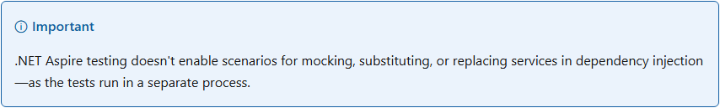
Testing

Slide 76
🏋️‍♂️ Hands-on #8
Write test for ApiService
📁 WS-AspireApp-HandsOn\08-Test-ApiService
👣 Steps:
Create new project – ‘.NET Aspire Starter App’, in ‘Create a test project’ select ‘NUnit’
Add new test to the WebTests.cs file

Slide 77
Testing
Be aware of quality of automated tests -> isolation, reproducibility

Slide 78
FAQ, Problems

Slide 79
Common problems
Not configuring .WithReference in AppHost project
Not using extension methods from ‘ServiceDefaults’ project in app parts
Using different names in AppHost integration than in Client integration

Slide 80
Other cloud providers?
https://aws.amazon.com/blogs/developer/integrating-aws-with-net-aspire/
Not aware of Google Cloud support

Slide 81
Thank you! Questions?
https://www.linkedin.com/in/ldurovsky/

Slide 82
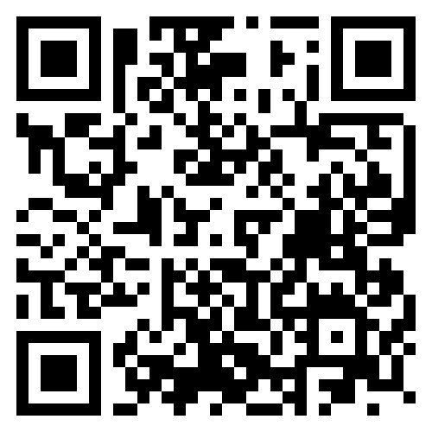

Slide 83
Resources
https://learn.microsoft.com/en-us/dotnet/aspire/

